Slide 1
QA for Android devices Exploring Android Calculator Architecture: Project Structure, Functionality, and Testing
A presentation by Reviewed by
Anupam Prof. Abhishek Asha Harsh Vardhan Hrushikesh Manish Krishna Tahir
Date – 07/06/2024

Slide 2

Table of content
Following topics will be discussed in the presentation
1. Introduction to Android calculator 2. Architecture overview 3. Project structure 4. Flow chart 5. UI Testing 6. Types of UI testing 7. Unit Testing 8. Test cases for android calculator 9. Traceability matrix 10. Conclusion

Slide 3

Introduction to Android Calculator
Brief Overview:
Android calculator apps are ubiquitous tools on Android devices, serving essential functions for users.
Usage Scenarios:
Integral to everyday tasks such as budgeting, calculations, and academic or professional use.
Enhances productivity and convenience, making complex calculations accessible on the go.
Purpose:
The architecture design and testing process ensure the reliability, efficiency, and user friendliness of the calculator app.
Essential for delivering a seamless and accurate user experience, meeting the diverse needs of Android users.

Slide 4
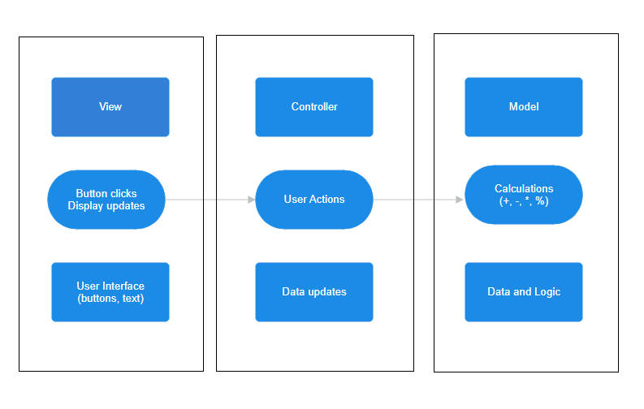
Architecture Overview
An Android calculator app typically follows a Model-View-Controller (MVC) architecture for a well-organized and maintainable codebase. Here's a breakdown of the components and their roles:
Model:
Handles the data and logic behind the calculations. This can involve classes representing numbers, operators, and the overall expression being built. The model performs the actual calculations based on the user input and stores the intermediate and final results.
View:
Represents the user interface (UI) elements of the calculator. This includes the buttons for numbers, operators, and functions like clear, delete, etc. The view displays the current expression being built and the final result calculated by the model. Listens for user interactions like button clicks and updates the model accordingly.
Controller:
Acts as the intermediary between the view and the model. Receives user input from the view (button clicks). Updates the model with the new data or operation. Retrieves the results from the model and updates the view (display) with the latest information. The controller essentially translates user actions into operations for the model and updates the UI based on the model's output.
Presentation Layer
Data Layer
Logic Layer

Slide 5
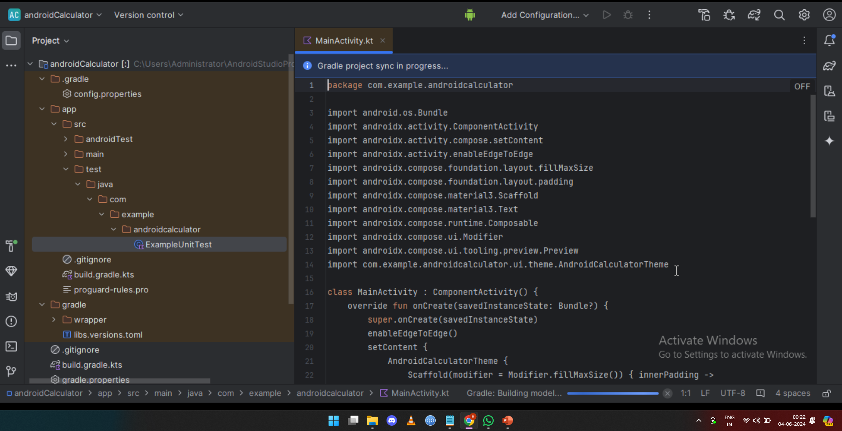
Project Structure in Android Studio
Key Directories and Files
app/src/main/java:
Contains the Java code for the Android calculator app.
Includes classes and packages responsible for implementing app functionality.
app/src/main/res:
Stores resources used by the app, such as XML layout files, images, and strings.
Organized into subdirectories for different types of resources (e.g., layout, drawable, values).
Gradle Files:
app/build.gradle:
Configuration file for the app module, including dependencies and build settings.
Project-level Gradle files:
settings.gradle and build.gradle:
Configure project-wide settings and dependencies.
Manage the overall build process for the Android calculator project.

Slide 6
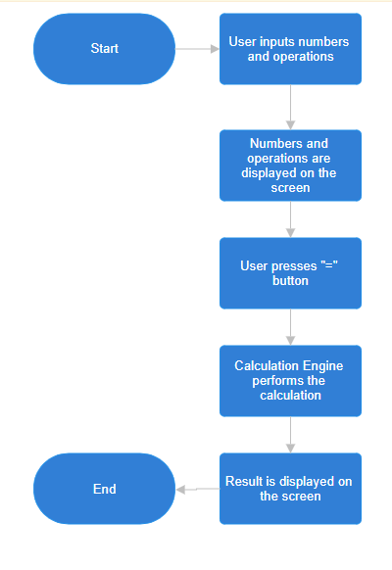
Flow Chart of Calculator Functionality
In essence, this flowchart represents a fundamental model of how a basic calculator operates. It captures the user's input, processes it mathematically, and delivers the final outcome on the screen.
Start: The process begins here.
User inputs numbers & operations: The user interacts with the calculator by pressing buttons to enter numbers and desired operations (addition, subtraction, etc.).
As the user inputs numbers and operations, they are simultaneously displayed on the calculator's screen, providing a real-time view of the expression being built.
User presses "=" button: Once the user has entered the complete expression, they press the "=" button to initiate the calculation.
Calculation Engine performs the calculation: Upon receiving the equal sign command, the calculator's processing unit, referred to as the Calculation Engine in the flowchart, takes over. It retrieves the entered expression, processes it according to the order of operations (PEMDAS - Parentheses, Exponents, Multiplication and Division from left to right, Addition and Subtraction from left to right), and calculates the final result.
Result is displayed on the screen: The calculated answer is then presented on the calculator's display for the user to view.
End: The process reaches its conclusion after the result is shown on the screen. The calculator essentially waits for further user input to begin a new calculation cycle.

Slide 7
UI Testing
Introduction to UI Testing
UI testing ensures the functionality and responsiveness of the Android calculator's user interface.
It simulates user interactions with UI elements such as buttons, input fields, and displays.
UI Testing Process
Writing UI tests using frameworks like Espresso or UI Automator.
Defining test scenarios to cover various user interactions and edge cases.
Executing tests on emulators or physical devices to validate UI behavior.
Benefits of UI Testing
Identifies UI-related bugs and inconsistencies early in the development process.
Ensures a seamless and intuitive user experience for the Android calculator app.
Increases confidence in the app's reliability and robustness across different devices and
screen sizes.

Slide 8


Types of UI Testing
Espresso Testing Framework:
Espresso is a widely-used UI testing framework for Android apps. It provides a fluent and concise API for writing UI tests, making test code readable and maintainable. Espresso tests run asynchronously, allowing for synchronization with the app's UI thread, ensuring reliable and accurate results.
UI Automator Framework:
UI Automator is another UI testing framework provided by Google for Android apps. It allows testers to write tests that interact with multiple apps across different system-level UI components. UI Automator tests are useful for scenarios requiring interactions with elements outside of the app under test, such as notifications or system dialogs.
Snapshot Testing:
Snapshot testing is a UI testing technique that captures the visual representation of a UI component at a specific point in time. In Android UI testing, snapshot testing involves capturing screenshots of UI elements or entire screens and comparing them against reference images. It helps in detecting visual regressions, such as unexpected layout changes or visual glitches, by identifying differences between the captured snapshots and the expected reference images.

Slide 9

Unit Testing
Unit testing is a software testing technique where individual units or components of a software application are tested in isolation.
In the context of an Android calculator, unit testing involves testing each arithmetic operation (addition, subtraction, multiplication, division) and other logical components independently.
Unit tests verify the correctness of specific functionalities without considering the integration with other parts of the application, focusing on the smallest testable parts of the codebase.

Slide 10
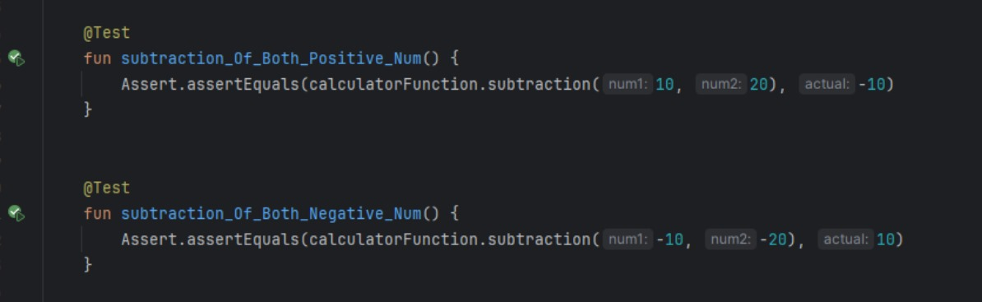
Test Cases for the Android Calculator
The first test method verifies whether the subtraction operation for positive numbers in the Android calculator app's calculatorFunction class returns the correct result (-10). If the actual result matches the expected result, the test will pass; otherwise, it will fail, indicating a potential issue with the subtraction functionality for positive numbers. The second test method verifies whether the subtraction operation for negative numbers in the Android calculator app's calculatorFunction class returns the correct result (10). If the actual result matches the expected result, the test will pass; otherwise, it will fail, indicating a potential issue with the subtraction functionality.

Slide 11
Traceability Matrix
The traceability matrix maps test cases to requirements, detailing their descriptions and results. Test cases TC001 and TC002 verify subtraction functionality for negative and positive numbers, respectively. While TC001 and TC002 passed during execution.
Test case Id | Requirement ID | Description | Result
TC001 | REQ001 | Verify subtraction for negative numbers | Pass
TC002 | REQ002 | Verify subtraction for positive numbers | Pass

Slide 12


Slide 13
By adopting a structured architecture like MVC, we ensure the code is well-organized, easier to maintain in the long run, and potentially reusable for similar projects.
Investing in a comprehensive testing process is crucial. It helps catch bugs early on, leading to a higher quality app and increased user trust.
As we look ahead, there's always room for improvement. We could explore adding more advanced functionalities, improve user experience with features like history or customization, and prioritize accessibility features for a broader user base. Espresso and UI Automator are prominent UI testing frameworks for Android apps, offering distinct advantages. Espresso provides a concise API for writing tests, ensuring readability and asynchronous execution for reliable results. On the other hand, UI Automator allows interaction with system-level UI components, facilitating testing scenarios beyond the app under test. Snapshot testing captures UI elements' visual representation, aiding in detecting visual regressions by comparing captured screenshots with reference images. Unit testing isolates and examines individual components of an application, ensuring each functions correctly on its own. For an Android calculator, this means testing arithmetic operations and logical components independently to verify their accuracy. These tests focus solely on the specific functionality of each component, ignoring integration with other parts of the app.

Slide 14
Thank You
.

